Slide 1
Joint models for kidney transplant data
Department of Biostatistics, Erasmus MC

Slide 2
Survival submodel Association with log(pcr)
 | Mean | Std. Dev | 2.5% | 97.5% | P
d_age | 0.014 | 0.008 | -0.001 | 0.033 | 0.090
tx_previoustx: Yes | 0.997 | 0.309 | 0.173 | 1.518 | 0.008
rec_bmi | 0.116 | 0.022 | 0.071 | 0.153 | <0.000
d_type: LRD | -0.096 | 0.200 | -0.515 | 0.204 | 0.656
d_type: LURD | 0.020 | 0.114 | -0.168 | 0.275 | 0.986
d_type: NHBD | -0.465 | 0.300 | -0.989 | 0.048 | 0.108
tx_hla | 0.031 | 0.058 | -0.074 | 0.166 | 0.572
rec_age | -0.002 | 0.008 | -0.020 | 0.015 | 0.724
tx_pra | 0.005 | 0.006 | -0.006 | 0.018 | 0.352
log(pcr) | 0.534 | 0.097 | 0.351 | 0.734 | <0.000

Slide 3
Survival submodel Association with log(pcr) & slope: log(pcr)
 | Mean | Std. Dev | 2.5% | 97.5% | P
d_age | 0.013 | 0.007 | 0.001 | 0.030 | 0.046
tx_previoustx: Yes | 1.054 | 0.261 | 0.320 | 1.426 | 0.002
rec_bmi | 0.120 | 0.017 | 0.082 | 0.151 | <0.000
d_type: LRD | -0.219 | 0.208 | -0.484 | 0.161 | 0.368
d_type: LURD | 0.001 | 0.093 | -0.151 | 0.227 | 0.696
d_type: NHBD | -0.627 | 0.268 | -0.989 | -0.010 | 0.044
tx_hla | 0.043 | 0.045 | -0.06 | 0.135 | 0.334
rec_age | -0.003 | 0.006 | -0.015 | 0.012 | 0.426
tx_pra | 0.005 | 0.005 | -0.004 | 0.016 | 0.182
log(pcr) | 0.534 | 0.077 | 0.375 | 0.712 | <0.000
Slope: log(pcr) | 0.010 | 0.044 | -0.072 | 0.117 | 0.540

Slide 4
Survival submodel Association with log(creatinine)
 | Mean | Std. Dev | 2.5% | 97.5% | P
d_age | -0.004 | 0.007 | -0.017 | 0.013 | 0.428
tx_previoustx: Yes | 1.139 | 0.215 | 0.597 | 1.536 | <0.000
rec_bmi | 0.099 | 0.019 | 0.060 | 0.135 | <0.000
d_type: LRD | -0.241 | 0.242 | -0.710 | 0.094 | 0.406
d_type: LURD | 0.009 | 0.093 | -0.173 | 0.257 | 0.870
d_type: NHBD | -1.214 | 0.273 | -1.697 | -0.506 | 0.004
tx_hla | 0.026 | 0.051 | -0.103 | 0.117 | 0.526
rec_age | 0.018 | 0.007 | 0.004 | 0.034 | 0.026
tx_pra | 0.002 | 0.005 | -0.008 | 0.013 | 0.482
log(creatinine) | 2.110 | 0.165 | 1.698 | 2.372 | <0.000

Slide 5
Survival submodel Association with log(creatinine) & slope: log(creatinine)
 | Mean | Std. Dev | 2.5% | 97.5% | P
d_age | -0.003 | 0.007 | -0.018 | 0.012 | 0.528
tx_previoustx: Yes | 1.131 | 0.224 | 0.630 | 1.607 | 0.000
rec_bmi | 0.097 | 0.017 | 0.061 | 0.131 | 0.000
d_type: LRD | -0.245 | 0.221 | -0.556 | 0.104 | 0.35
d_type: LURD | 0.012 | 0.093 | -0.179 | 0.245 | 0.584
d_type: NHBD | -1.190 | 0.261 | -1.661 | -0.570 | 0.008
tx_hla | 0.015 | 0.039 | -0.071 | 0.095 | 0.574
rec_age | 0.019 | 0.006 | 0.006 | 0.034 | 0.016
tx_pra | 0.002 | 0.005 | -0.009 | 0.013 | 0.42
log(creatinine) | 2.097 | 0.139 | 1.766 | 2.363 | 0.000
Slope: log(creatinine) | 0.507 | 0.264 | -0.006 | 1.072 | 0.064

Slide 6
Survival submodel Association with log(pcr) & log(creatinine)
 | Mean | Std. Dev | 2.5% | 97.5% | P
d_age | 0.012 | 0.025 | -0.032 | 0.060 | 0.652
tx_previoustx: Yes | 1.078 | 0.746 | -0.072 | 2.555 | 0.120
rec_bmi | 0.121 | 0.063 | -0.009 | 0.242 | 0.066
d_type: LRD | -0.298 | 0.775 | -2.455 | 0.721 | 0.776
d_type: LURD | -0.017 | 0.592 | -1.495 | 1.301 | 0.982
d_type: NHBD | -0.861 | 0.850 | -2.778 | 0.201 | 0.248
tx_hla | 0.054 | 0.161 | -0.261 | 0.400 | 0.728
rec_age | 0.014 | 0.022 | -0.026 | 0.062 | 0.516
tx_pra | 0.004 | 0.015 | -0.030 | 0.030 | 0.718
log(pcr) | 0.156 | 0.154 | -0.101 | 0.483 | 0.260
log(creatinine) | 0.934 | 0.515 | -0.011 | 1.975 | 0.068

Slide 7
Survival submodel Association with log(pcr) & log(creatinine)
 | Mean | Std. Dev | 2.5% | 97.5% | P
d_age | 0.014 | 0.024 | -0.029 | 0.065 | 0.552
tx_previoustx: Yes | 1.015 | 0.775 | -0.138 | 2.617 | 0.164
rec_bmi | 0.126 | 0.062 | 4.009e-4 | 0.244 | 0.048
d_type: LRD | -0.281 | 0.677 | -2.103 | 0.58 | 0.784
d_type: LURD | -0.046 | 0.606 | -1.678 | 1.172 | 0.928
d_type: NHBD | -0.754 | 0.759 | -2.541 | 0.165 | 0.268
tx_hla | 0.028 | 0.174 | -0.308 | 0.398 | 0.902
rec_age | 0.015 | 0.022 | -0.029 | 0.06 | 0.494
tx_pra | 0.003 | 0.015 | -0.029 | 0.029 | 0.792
log(pcr) | 0.147 | 0.144 | -0.097 | 0.454 | 0.294
Slope: log(pcr) | 0.051 | 0.148 | -0.206 | 0.386 | 0.764
log(creatinine) | 0.902 | 0.476 | 0.014 | 1.817 | 0.030
Slope: log(creatinine) | 0.410 | 0.474 | -0.185 | 1.605 | 0.366

Slide 8
Longitudinal submodel: creatinine
 | Mean | Std. Dev | 2.5% | 97.5% | P
Intercept | 4.955 | 0.198 | 4.577 | 5.353 | <0.000
rec_age: Follow up 1 | -0.005 | 0.002 | -0.008 | -0.001 | <0.000
rec_gender: Male | 0.213 | 0.042 | 0.131 | 0.294 | <0.000
d_age | 0.007 | 0.002 | 0.003 | 0.010 | <0.000
tx_dgf: Yes | 0.124 | 0.047 | 0.035 | 0.217 | 0.006
d_bmi | -0.003 | 0.005 | -0.012 | 0.006 | 0.526
tx_hla | 0.006 | 0.014 | -0.022 | 0.032 | 0.680
tx_previoustx: Yes | 0.004 | 0.061 | -0.112 | 0.120 | 0.958
tx_pra | 0.002 | 0.001 | -0.001 | 0.005 | 0.234
tx_cit | 1.463e-4 | 4.686e-5 | 5.425e-5 | 2.404e-4 | <0.000
tx_dial_days | 1.429e-5 | 1.653e-5 | 1.622e-5 | 4.610e-5 | 0.426
tx_dm: Yes | -0.127 | 0.059 | -0.242 | -0.014 | 0.034
rec_bmi | 0.005 | 0.005 | -0.005 | 0.014 | 0.356
Spline: 0 to 100 | -0.241 | 0.034 | -0.312 | -0.175 | <0.000
Spline: 100 to 300 | 0.026 | 0.071 | -0.112 | 0.166 | 0.678
Spline: 300 to 1000 | -0.438 | 0.204 | -0.867 | -0.061 | 0.026
Spline: 1000 to 4015 | 0.184 | 0.356 | -0.519 | 0.869 | 0.594

Slide 9
Longitudinal submodel: pcr
 | Mean | Std. Dev | 2.5% | 97.5% | P
Intercept | 3.069 | 0.467 | 2.127 | 3.972 | <0.000
d_age | 0.017 | 0.004 | 0.008 | 0.025 | <0.000
rec_bmi | -0.013 | 0.011 | -0.034 | 0.008 | 0.220
d_type: LRD | -0.231 | 0.221 | -0.663 | 0.190 | 0.308
d_type: LURD | -0.287 | 0.218 | -0.680 | 0.164 | 0.190
d_type: NHBD | -0.022 | 0.112 | -0.236 | 0.195 | 0.848
d_bmi | 0.001 | 0.011 | -0.019 | 0.023 | 0.942
tx_cit | 1.681e-4 | 1.560e-4 | 1.433e-4 | 4.680e-4 | 0.262
tx_hla | 0.012 | 0.035 | -0.055 | 0.078 | 0.722
rec_age: Follow up 1 | 0.002 | 0.004 | -0.005 | 0.010 | 0.554
tx_previoustx: Yes | 0.126 | 0.145 | -0.168 | 0.405 | 0.410
tx_dial_days | -1.086e-05 | 3.940e-5 | 9.069e-5 | 6.259e-5 | 0.802
tx_dm: Yes | 0.087 | 0.137 | -0.182 | 0.349 | 0.526
tx_pra | 0.003 | 0.004 | -0.005 | 0.009 | 0.514
Spline: 0 to 100 | -0.754 | 0.083 | -0.912 | -0.586 | <0.000
Spline: 100 to 200 | -0.218 | 0.233 | -0.695 | 0.225 | 0.332
Spline: 200 to 350 | -0.191 | 0.455 | -1.103 | 0.732 | 0.648
Spline: 350 to 4015 | 2.166 | 0.994 | 0.250 | 4.160 | 0.022

Slide 10
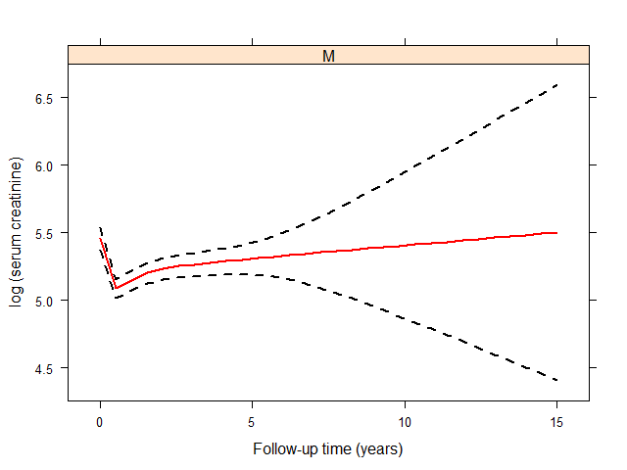
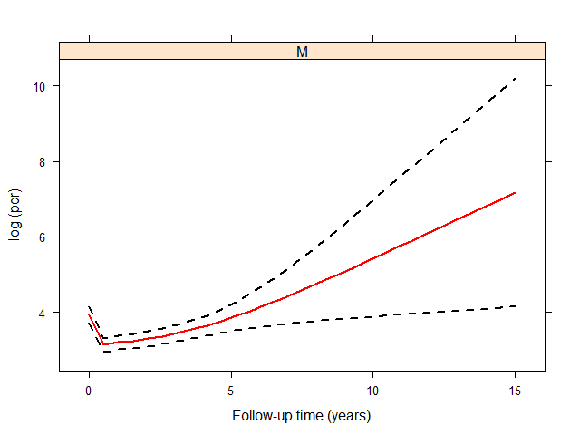
Longitudinal Evolution

Slide 11
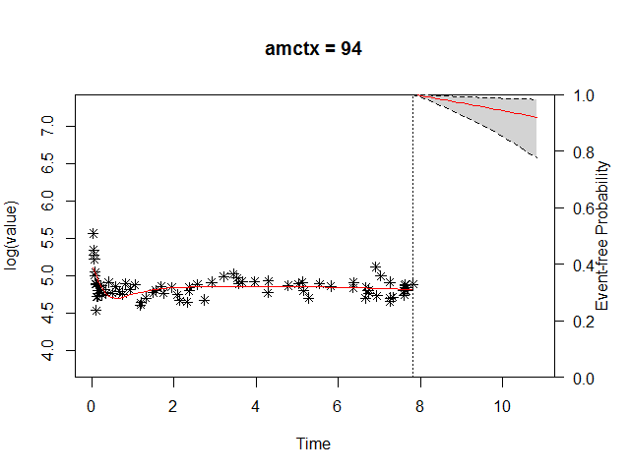
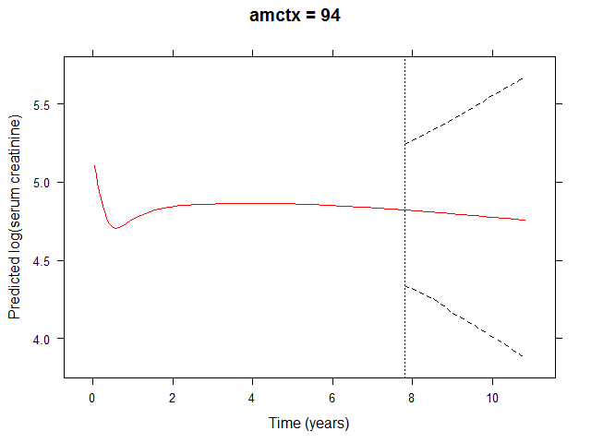
Subject specific predictions

Slide 12
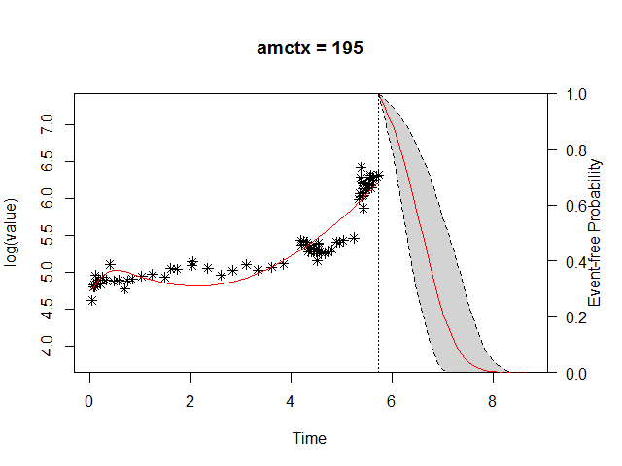
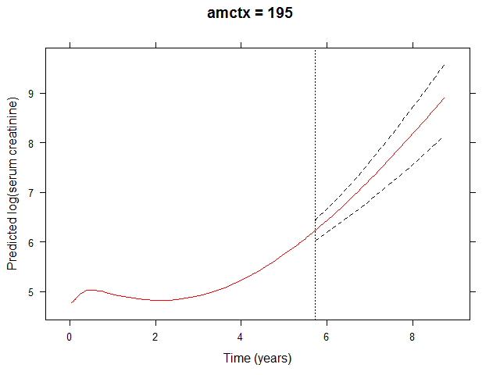
Subject specific predictions

Slide 13
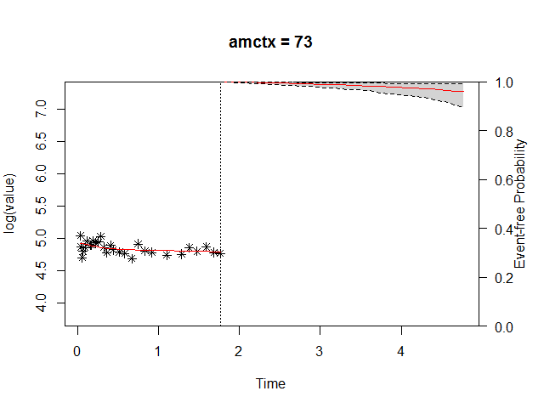
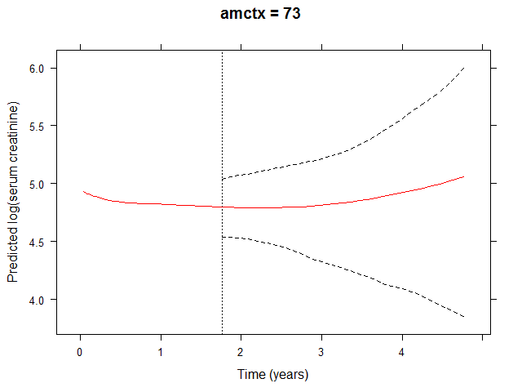
Subject specific predictions

Slide 14
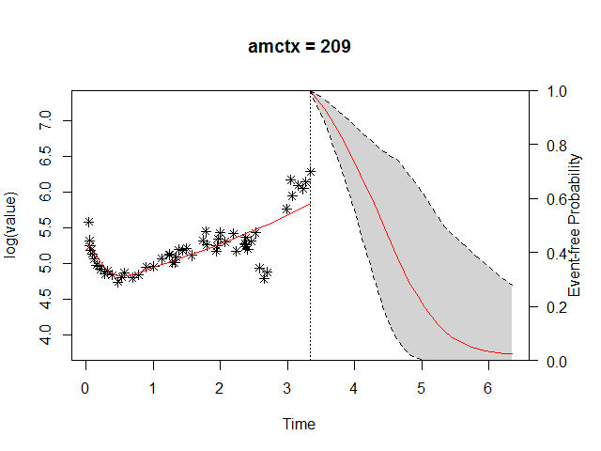
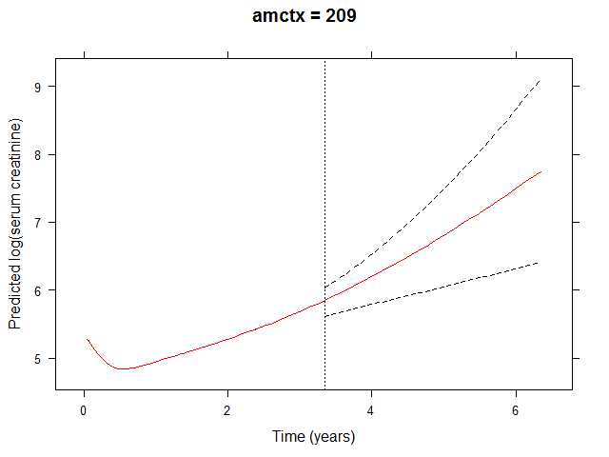
Subject specific predictions

Slide 15
Time dependent ROC

